Slide 1

Lab Book 0.3. Ring Resonator concepts
Student: Jesús Ugeda Mas
https://github.com/jugemas/pic-lab0

Slide 2
Instructions
General
SCRIPTS AND WORKFLOW
1. Fork / clone the repository: https://github.com/cccanvas-upv/pic-upv-lab0.git
2. Open the repository in VS Code with WSL; run uv sync if needed.
3. Select the project .venv as your Jupyter kernel.
4. Run 030_RING_RESONATOR_Student.ipynb in sequence.
5. Paste the requested plots and fill in your results in this LabBook.

Slide 3
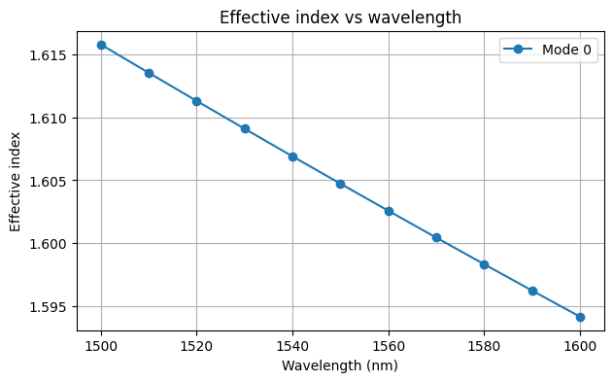
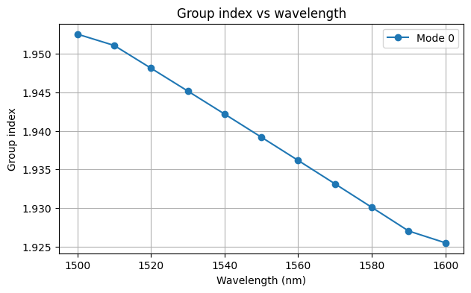
LO.1 – Effective and Group Index Analysis
Mode solver sweep: 1500–1600 nm (11 wavelengths), fundamental TE-like mode
At 1550 nm: n_eff = 1.60473, n_g = 1.93918
Explain the difference between effective and group indices. Comment on their wavelength dependence.
The effective index (n_eff) of a waveguide can be understood as the equivalent refractive index that light “feels” during its propagation. For a given mode, the value of n_eff lays between the indexes of the core and the cladding, which implies that n_eff informs about the degree of light confinement for the mode. On the other hand, the group index (n_g) describes how a wave package propagates through the waveguide, as it is related to the group velocity.
In the figures above, we show n_eff and n_g for the fundamental mode (after assuring it is the first TE mode) of a straight deep waveguide as a function of wavelength. As expected, both have a smooth and decreasing behaviour when increasing wavelength.
LAB 0.3. RING RESONATORS
3

Slide 4
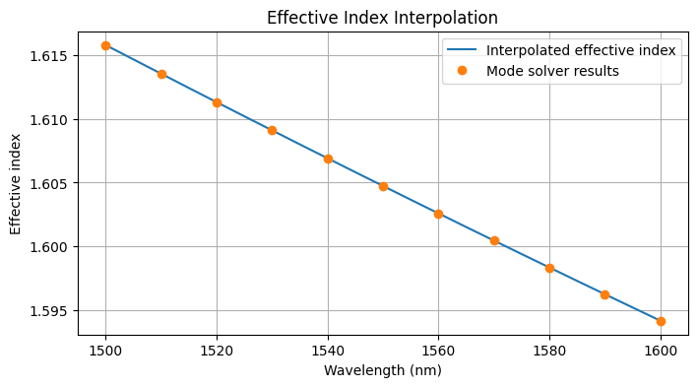
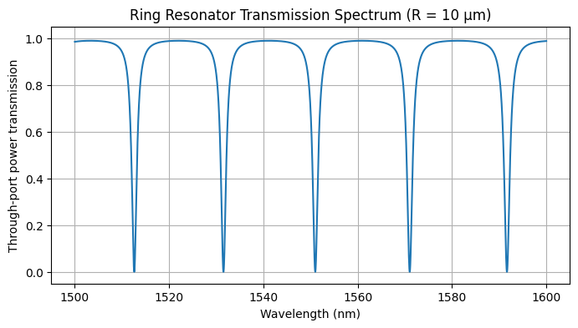
LO.2 – Ring Resonator Spectral Response
Interpolate n_eff(λ), then calculate the through-port spectrum of an all-pass ring (R = 10 µm; a = y = 0.90).
List the resonance wavelengths and estimate the FSR near 1550 nm.
The resonant wavelengths we can see at the figure on the right are: 1512.6 nm, 1531.5 nm, 1551.0 nm, 1571.03 nm, 1591.65 nm.
FSR is not constant: 18.93 - 19.46 - 20.02 - 20.62 (nm).
Explain why transmission reaches a minimum at resonance and approaches unity off resonance.
The transmission at the output is determined by an interference between the optical field that travels through the straight waveguide and the one coupling back from the ring. That is why the pattern shown in the figure relates so easily to interferometric phenomena.
At resonance, the field inside the ring interferes constructively after each round trip. Then, the field coupled back to the waveguide interferes destructively with the field there, generating a power dip. This power fall approaches zero when coupling and intrinsic losses balance exactly (a=y). Finally, off resonance, we have the opposite situation: field at the ring does not add up (destructive interference), leaving most of the optical power propagating through the straight waveguide.
LAB 0.3. RING RESONATORS
4

Slide 5
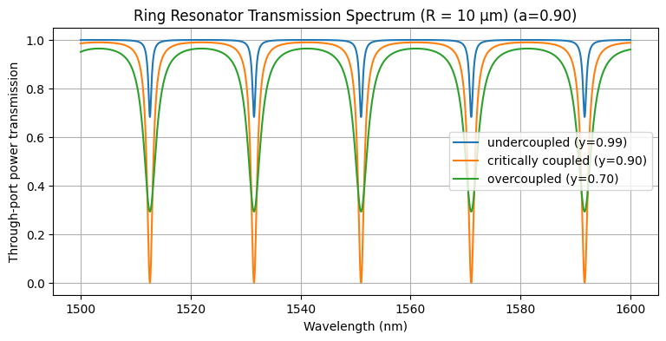
LO.3.1 – Influence of Coupling
y | Regime
0.99 | Undercoupled
0.90 | Critical
0.70 | Overcoupled
Exercise 1 · Fix R = 10 µm and a = 0.90. Compare y = 0.99, 0.90 and 0.70.
Which condition produces the deepest dip? Why does critical coupling ideally suppress through-port transmission?
The deepest dip occurs at y = a, when coupling and intrinsic losses balance exactly (critical coupling). In this case, transmission ideally reaches zero because the amplitude of the both fields, the one in the straight waveguide and the one coupling back from the ring, is equal, but they have opposite phases (destructive interference).
On the other hand, we can observe that the other two cases show a dip not as deep as the critical case. This tells us already that the resonance is not as “great” as before, and that there will be some power transmission at all wavelengths.
In the undercoupled case, y > a, a large portion of the light remains in the waveguide (y≈1), coupling less power to the ring and, therefore, leaving a “weaker” destructive interference at the output. This results in weaker resonances as we can see at the figure. It can also be understood as the ring being dominated by its internal loss.
In the overcoupled case, y < a, light bleeds out faster through the coupler than it dissipates inside. Lowering ‘y’ means having less direct power in the straight waveguide because you are over-coupling it to the ring. The fact that exists a coupling limit in order to have a good response (critical case) tells us that the light is leaking out; that there are more losses. This can be seen through the power transmitted off resonance, which does not reach unity anymore; and also through the resonance’s shape, whose line-width increases and depth decreases.
LAB 0.3. RING RESONATORS
5

Slide 6
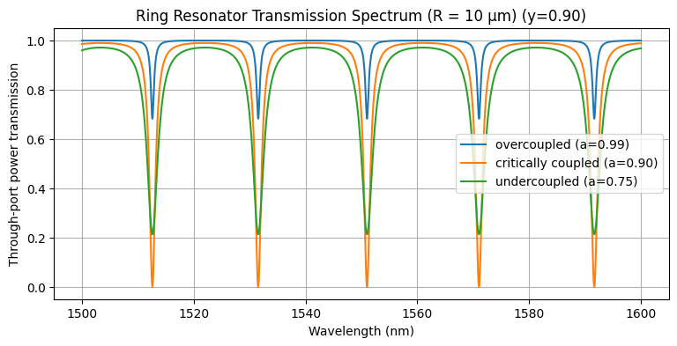
LO.3.1 – Influence of Coupling
a | Coupling regime
0.99 | Overcoupled
0.90 | Critical
0.75 | Undercoupled
Exercise 2 · Fix R = 10 µm and y = 0.90. Compare a = 0.99, 0.90 and 0.75.
How does increasing the propagation loss affect the resonance depth?
Which configuration satisfies the critical coupling condition?
Can increasing the internal losses produce a deeper resonance? Explain why.
This a-comparative and the previous y-comparative have similar behaviors, and both show specifically that only in critical coupling (a=y) the transmission reaches zero on resonance (ideally).
Increasing the losses at the ring means decreasing the ‘a’ value. As we can see in the figure, going from 0.99 to 0.90 improves the coupling and, therefore, the resonances. But surpassing this value does not imply that the coupling is going to continue improving. As we can see, going from 0.90 to 0.75 worsens the resonances.
In the undercoupled case, y > a, losses within the ring are big enough that the light at the end of each round trip has not enough energy to interfere as efficiently as it does in the critical case (the interference is not as “destructive” as before). Because of this, there is transmission at resonance wavelengths and the power does not reach unity off resonance.
In the overcoupled case, y < a, we see something similar to the case in the previous slide: y is lower than a, so we are trying to couple in the ring more light than the one needed for a critical case. The light will then bleed out and it will become a losses mechanism. However, this losses are lower than the previous ones because this time y = 0.90 and a = 0.99, which means that power is going to be closer to unity, as we can see.
LAB 0.3. RING RESONATORS
5

Slide 7
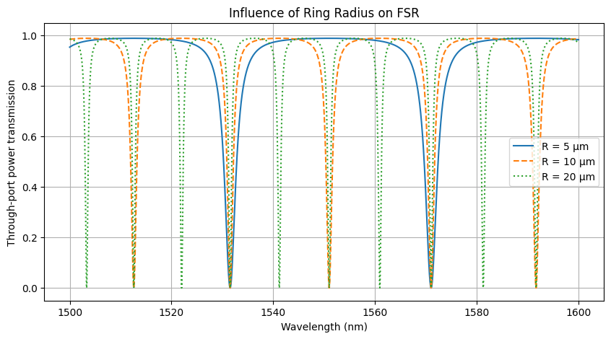
LO.3.2 – Ring Radius and FSR
R (µm) | Sim. FSR (nm) | Theory FSR (nm)
5 | 39.50 | 39.44
10 | 19.75 | 19.72
20 | 9.88 | 9.86
Exercise 3 · Fix a = y = 0.90; compare radii R = 5, 10 and 20 µm.
Questions:
How does the FSR change when the ring radius increases?
Explain physically why the FSR depends on the ring circumference.
Why is the FSR not exactly constant across the wavelength range?
For R = 5 μm, Sim. FSR is the separation between the two dips; but for R = 10 and 20 μm, we have taken the Sim. FSR as the mean of the 2 separations between dips in the 1550 nm vicinity, i.e. the distances between dip 5 an 6, and 6 and 7, for the dotted data (R = 20 μm).
As ring radius increases, the FSR decreases with ~1/R, but also depends on the wavelength and the group index, although this time we take n_g as a constant specified by n_g for 1550 nm. Those are the reasons to obtain Sim. FSR as we have done (explained in box above).
A bigger radius implies a longer optical path that light in the ring has to travel to complete a round trip, which implies at the same time a greater phase accumulation. Then, a greater phase shift between electric fields gives a smaller fulfilling “periodicity” of the condition of interference. That is the FSR.
However, if you expresses the FSR as a function of the wavelength, you see that it increases with ~λ². For example, at the exercise LO.2, we show some FSR values for a ring resonator (R = 10 µm, a = y = 0.90), which exemplifies this behaviour.
LAB 0.3. RING RESONATORS
7

Slide 8
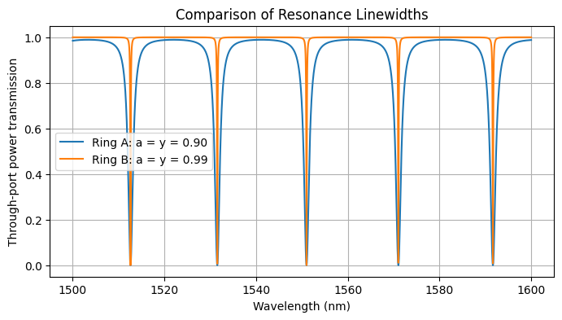
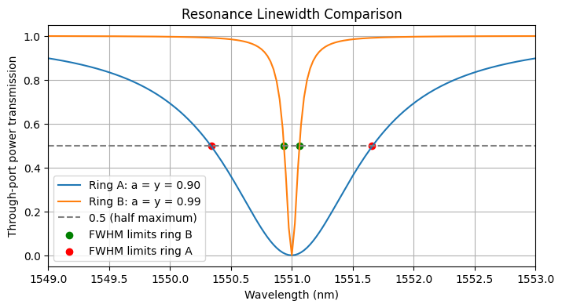
LO.3.3 – Resonance Linewidth
Exercise 4 · Ring A: a = y = 0.90; Ring B: a = y = 0.99. Both have R = 10 µm.
Estimate the FWHM graphically at half the dip depth (T ≈ 0.5). No extra simulations required.
We have thought that it will be more suitable for the data management to use the peaks_width() function available in python, whose results are somehow represented in the figure on the right.
Ring A: the cuts at T = 0.5 are 1550.34 nm y 1551.66 nm → FWHM = 1.32 nm.
Ring B: the cuts at T = 0.5 are 1550.94 nm y 1551.06 nm → FWHM = 0.13 nm.
LAB 0.3. RING RESONATORS
8

Slide 9
LO.3.3 – Finesse, Q-factor and Applications
Use the FSR from Exercise 3 and the visually estimated FWHM from Exercise 4.
Parameter | Ring A | Ring B
Resonance wavelength (nm) | 1551.0 | 1551.0
FSR (nm) | 19.75 | 19.75
Estimated FWHM (nm) | 1.32 | 0.13
Finesse | 15.01 | 153.30
Loaded Q-factor | 1178.73 | 12040.20
1. Which ring has a narrower resonance and higher Q? Why?
Ring B shows a narrower resonance and a higher Q-factor because the losses are lower and the light inside the ring lives for more round trips:
a = y = 0.99 > a = y = 0.90.
2. Which is preferable for detecting small resonance shifts in sensing?
Definitely ring B, because their resonances are narrower. This allows us to have a higher wavelength resolution, a higher sensitivity to changes in the refractive index, and therefore in the resonances, and, basically, a better ability to detect small shifts.
3. Is a narrower resonance always better for WDM filtering? Discuss bandwidth and stability.
On one hand, a narrow bandwidth gives you a better channel selectivity and a lower crosstalk between channels, but if it is too narrow, it may distort or clip a signal, losing key information in the process. On the other hand, as it would be very sensitive to thermal changes, fabrication variations, etc. the resonances can easily fall off the WDM signal channel. Then, it becomes almost completely necessary a fine tuning (i.e. thermal) that allows a controllable response.
LAB 0.3. RING RESONATORS
9

